Slide 1
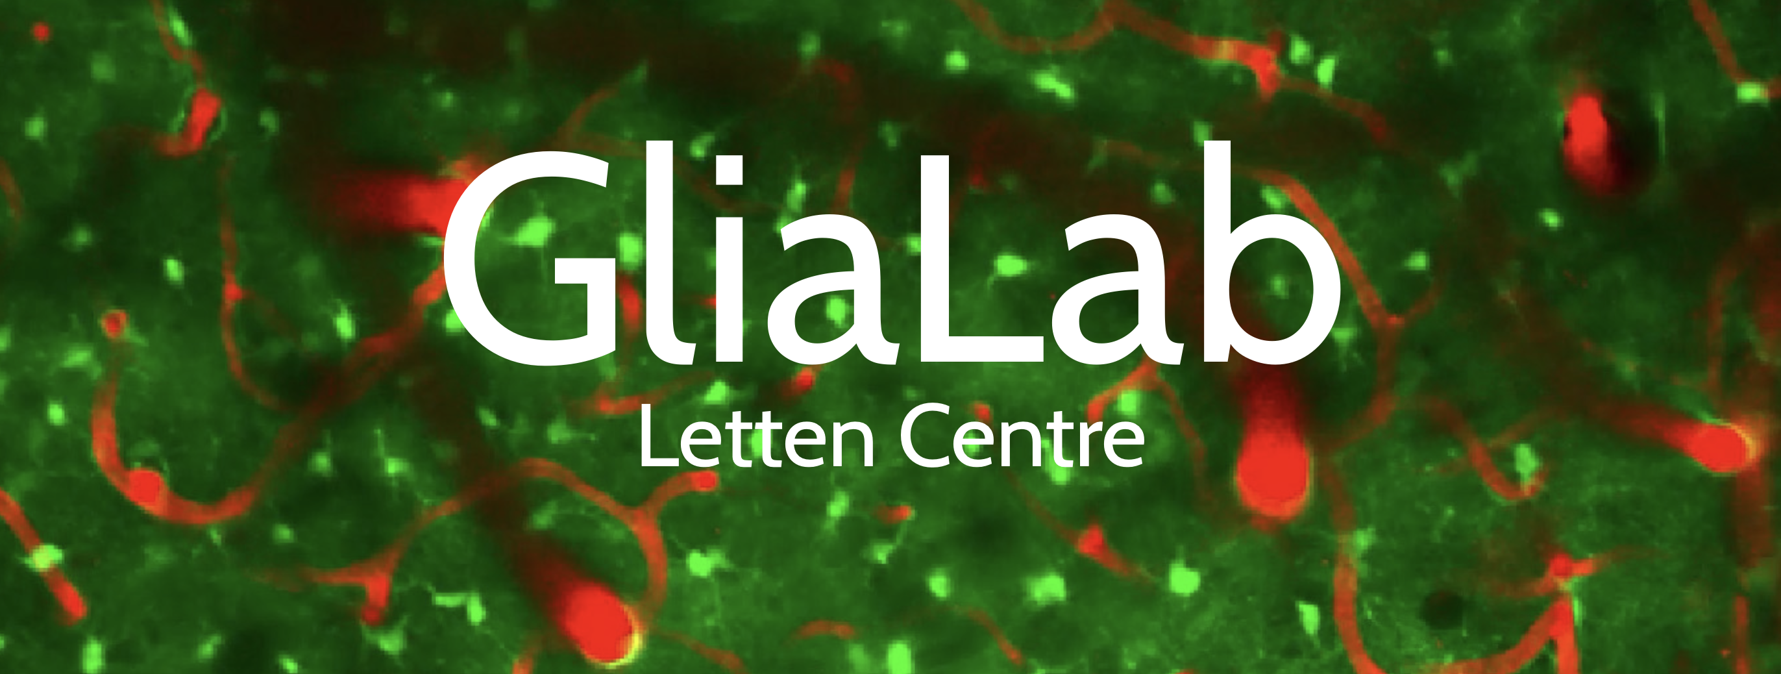
FYS9429 Project Ideas
Alessio Nespoli, Vegard Broen, and Anna Hjertvik Aasen

Slide 2
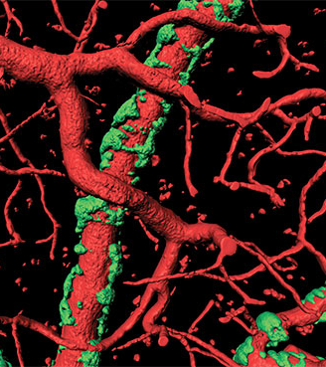
Project idea 1: Brain Vessel Plaque Prediction
Objective: Predict plaque formation in brain vessels using longitudinal data from Alzheimer’s mice.
Rationale:
Plaques develop around blood vessels in Alzheimer mice, restricting their movement.
Early vessel dynamics may contain predictive signals about where plaques will form.
Understanding these patterns could help identify at-risk vessels before plaques appear.
https://medicalxpress.com/news/2015-12-alzheimer-plaques-affect-brain-blood.html#google_vignette

Slide 3
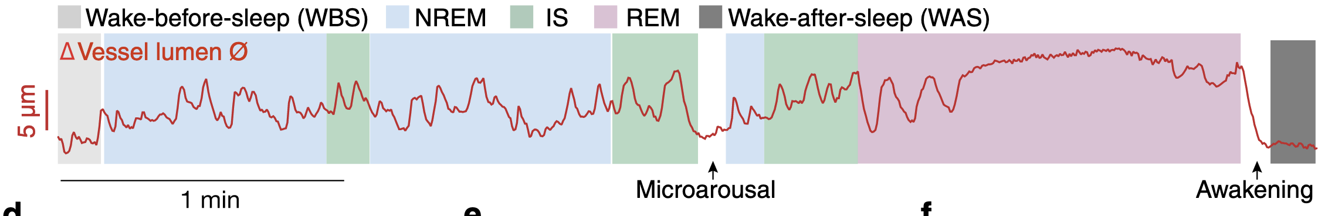
Project idea 1: Brain Vessel Plaque Prediction
Input Data:
Time series of vessel diameter showing constriction and dilation over time
Can include absolute diameters and/or relative changes
Data comes from mice at different stages:
Young: no plaques
Adult: some plaques
Old: plaques present
Opportunity: Explore which age/stage data contains the strongest predictive signals for plaque formation

Slide 4
Project idea 1: Brain Vessel Plaque Prediction
Potential ML Approaches:
CNNs: Feature extraction from vessel diameter time series
RNNs / LSTMs: Capture temporal patterns in constriction/dilation dynamics
Generative Models:
e.g., Variational Autoencoders (VAEs) for feature learning or data augmentation
Other Standard / Baseline Methods:
Linear regression, random forests, or gradient boosting on engineered features
Could serve as a benchmark before moving to deep learning
Note: These are starting ideas; other architectures or approaches can also be explored

Slide 5
Project idea 2: Vessel Dilation Prediction from EEG
Objective: Predict vessel dilation and constriction events from neural activity (EEG) patterns.
Rationale:
Knowing upcoming vessel movements could help intervene in experiments (e.g., optogenetics) to alter blood flow which is important for normal neural function.
Investigating EEG’s predictive power provides insights into the interaction between neuronal activity and vascular responses.
Stretch Goal:
Develop an online model for real-time vessel dilation prediction

Slide 6
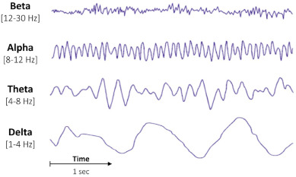
Project idea 2: Vessel Dilation Prediction from EEG
Input Data:
EEG signals (raw and/or filtered) capturing neural activity
Potential ML Approaches (Ideas Only):
CNNs: Extract temporal patterns from various bands of EEG signals
RNNs / LSTMs: Model sequential dependencies in neural activity
Generative Models:
e.g., VAEs or GANs for data augmentation or feature extraction
Note: These are starting ideas; other approaches can be explored
https://www.sciencedirect.com/topics/medicine-and-dentistry/gamma-wave

